Slide 1
Biblio-Finder
Search Engine for Academic Papers
Instructor: Dr. Jianguo Lu
Comp-8380: Information Retrieval Systems
By: Priyanka Motwani
Vinay Kiran Manjunath

Slide 2
Agenda
Introduction
Basic Search Engine
Implemented Features of Phase I and II
Page Ranking
Doc2vec
TF-IDF
Classification
Clustering
Conclusion
References

Slide 3
INTRODUCTION
Project Summary
Built a Search Engine that focuses on academic conference papers search
Basic Functionalities: Query Processing, Indexing and Searching
Improvements: Fast searching, searching different attributes,
Implemented Features of Phase I and II: Highlighting, Spellchecking, Word2vec, Autosuggestion.
Added features: Pagerank, TF-IDF, DOC2vec, Feature Selection, Clustering, Classification

Slide 4
BASIC SEARCH ENGINE
Search Engine:
Accepts a key term/ phrase as input and searches for results from the dataset
backend: Tomcat + Servlet
frontend: JSP + HTML + CSS
Data Source:
CiteSeer full text & meta data
.txt files ranged from 10.1.1.2.1 - 10.1.1.2.9999
.xml files - meta data
SIGMOD ICSE VLDB citation graph & meta data
18606 papers, 34380 edges
DBLP Version 1 - Aminer Dataset

Slide 5
BASIC SEARCH ENGINE – Cont'd
Data Source attributes:
docId, title, authors, year, conference, fulltext, citation, simdocs
Software Configuration:
Eclipse v4.14.0
Java packages
Apache Lucene v8.4.1
Tomcat server v9.0
Overleaf- Latex
Jupyter – Python
Sklearn library

Slide 6
Implemented Features of Phase I and II

Slide 7
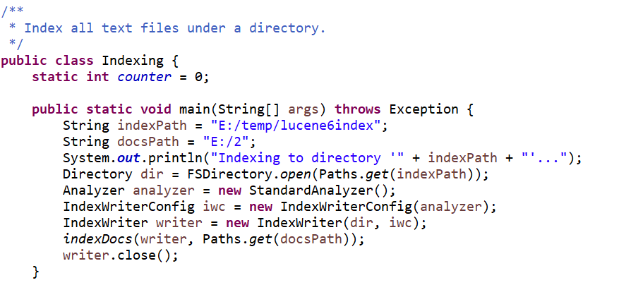
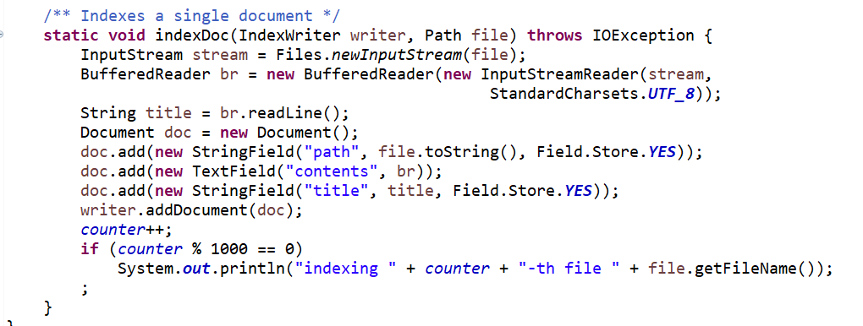
Creating Indexes from the document

Slide 8
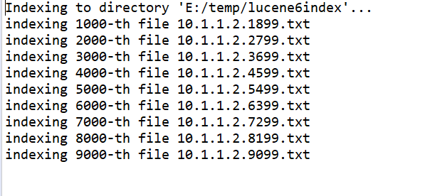
Indexing Results into the directory

Slide 9
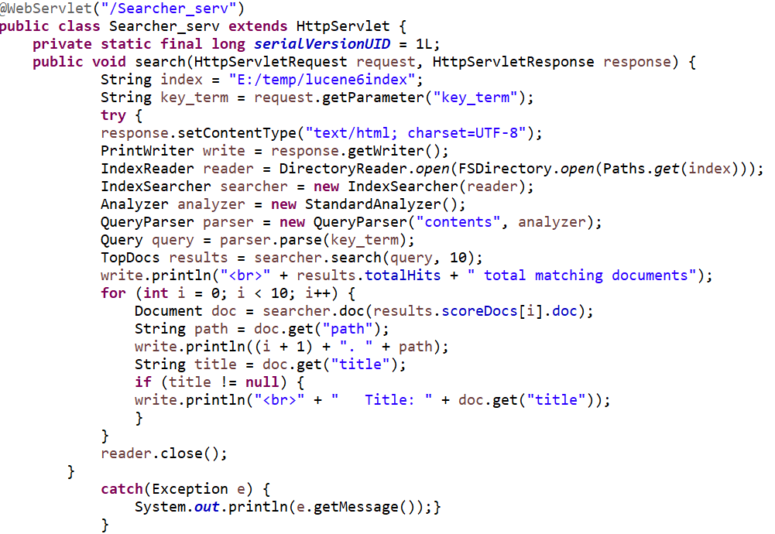
Creating Searcher

Slide 10
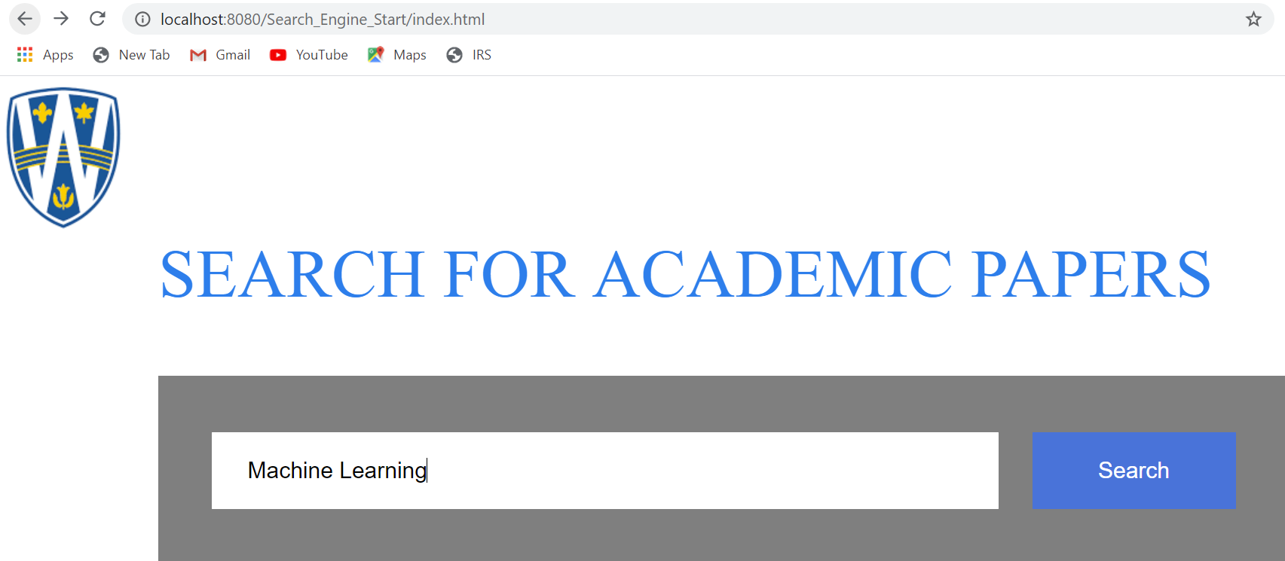
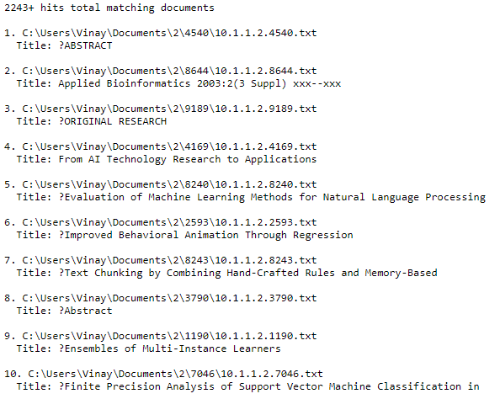
Indexing and Searching Results

Slide 11
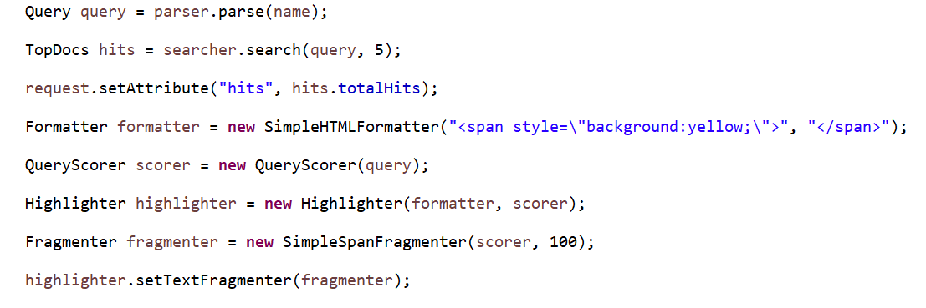
Implementing Highlighter

Slide 12
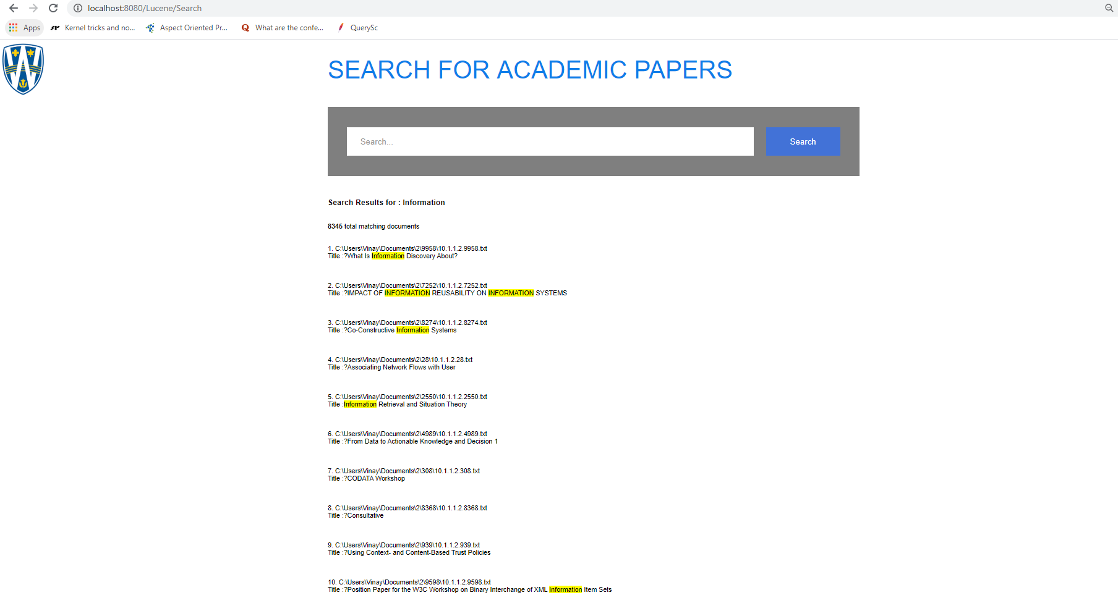
Highlighting Results
Search results for keyword: Information

Slide 13
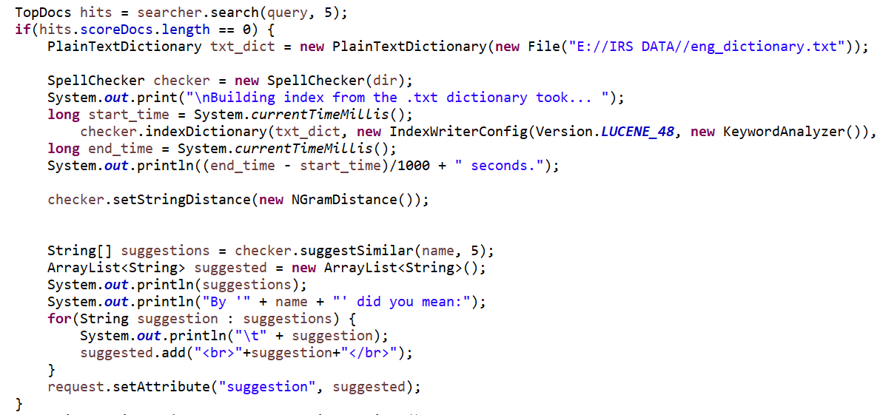
Implementing SpellChecking

Slide 14
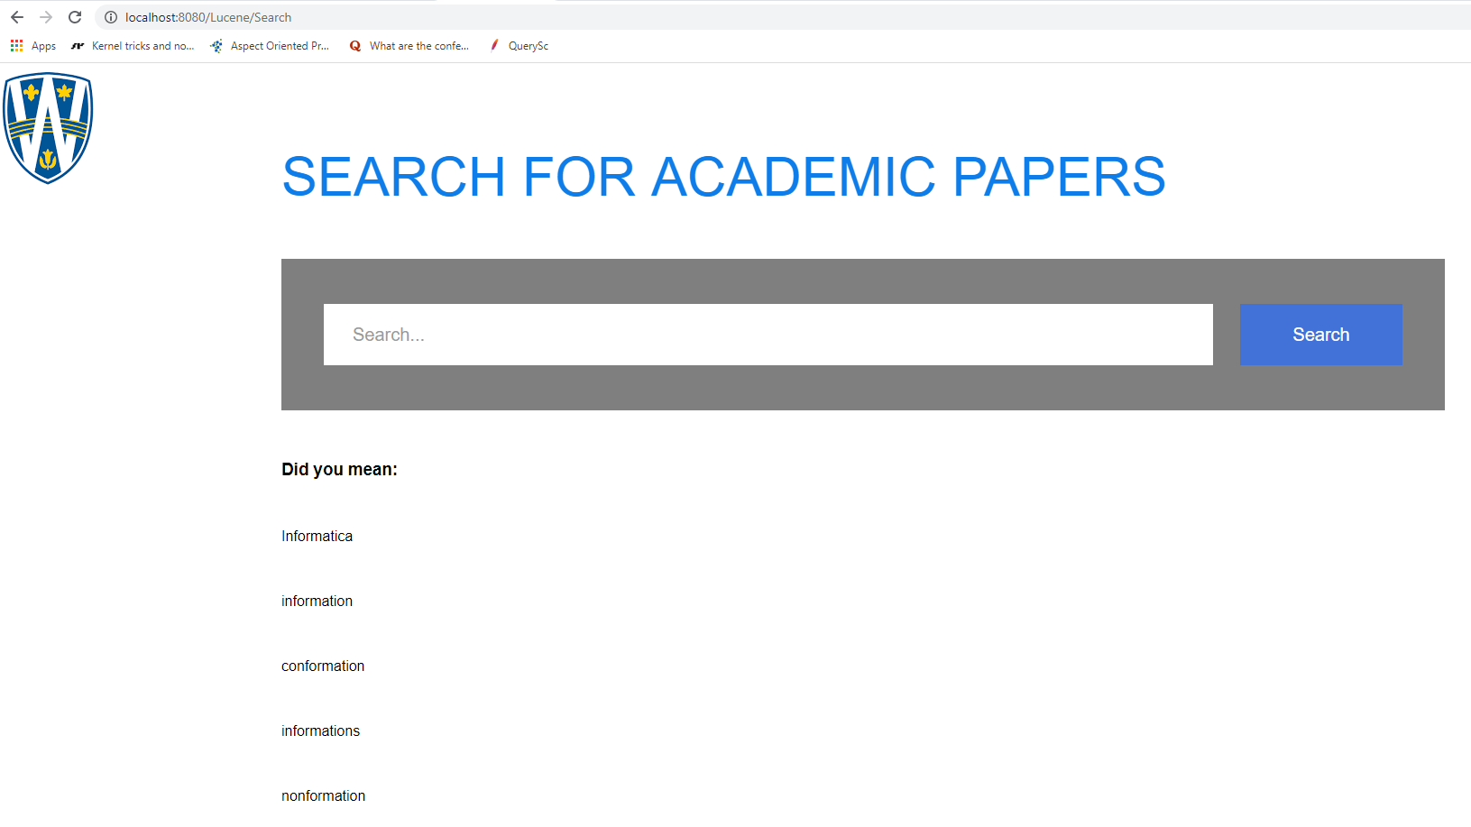
SpellChecking Results
Search results for keyword: Information

Slide 15
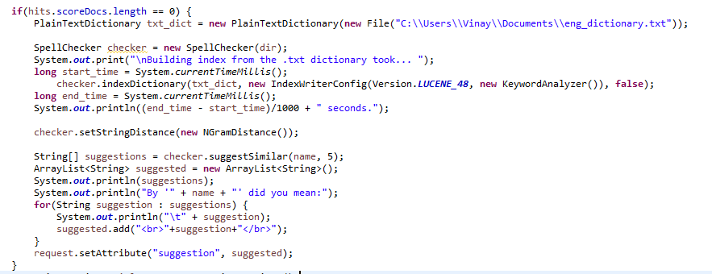
Auto Complete

Slide 16
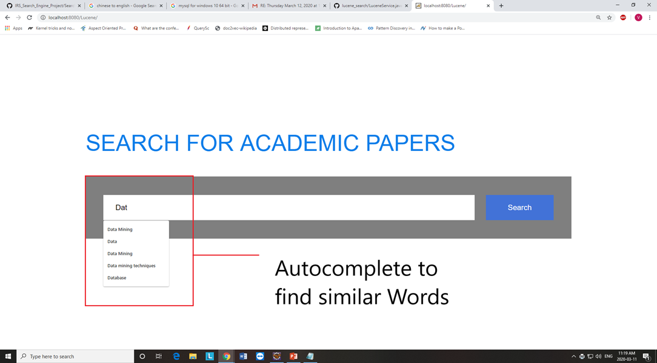
Auto Complete - Results

Slide 17
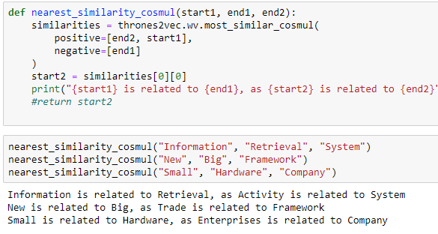
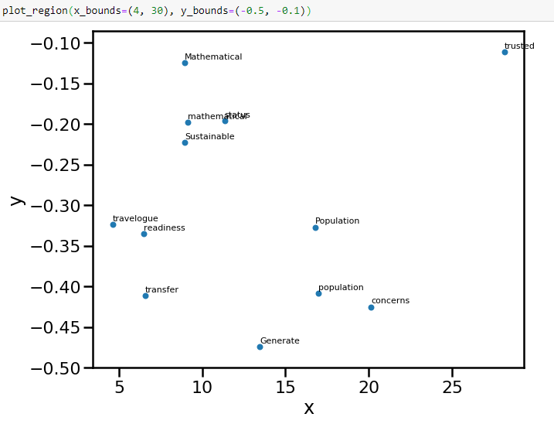
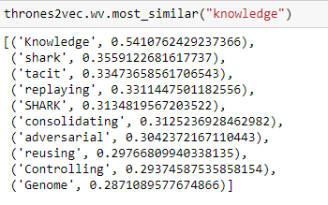
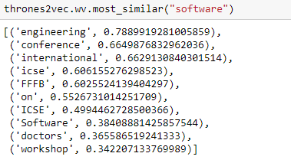
Word2vec- Implementation using Gensim
Finding the nearest similar words
Putting all the points of into a matrix and plotting in 2D
num_features = 300
min_word_count = 3
num_workers = multiprocessing.cpu_count()
context_size = 7
downsampling = 1e-3
seed = 1
Finding the most similar words from dataset

Slide 18
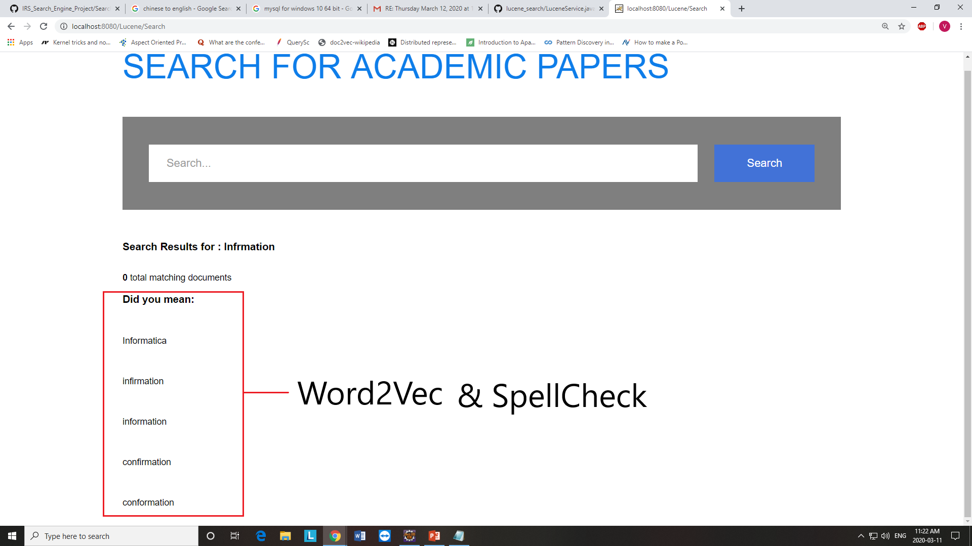
Word2vec - Results
Search results for keyword: Information

Slide 19
Features of the Final Phase

Slide 20
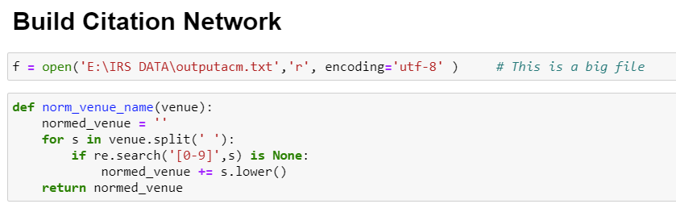
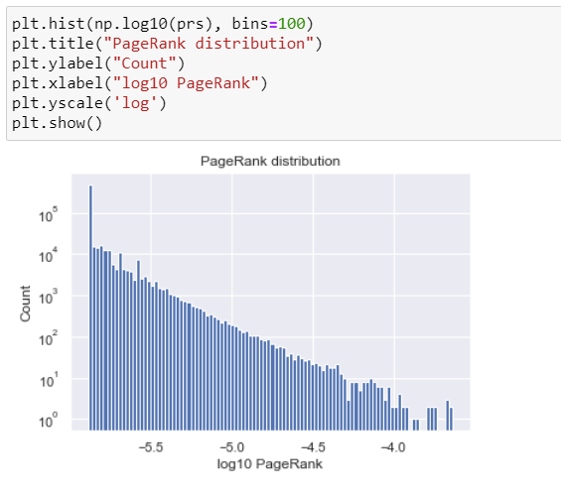
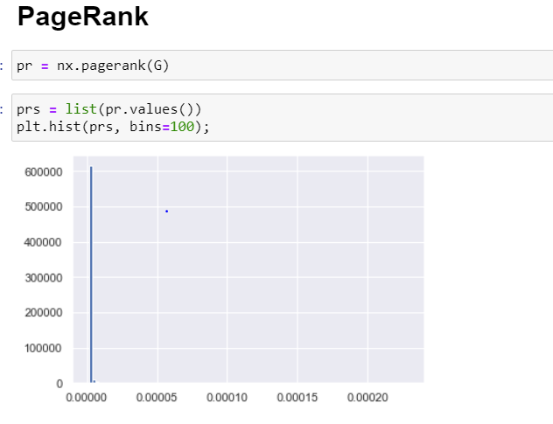
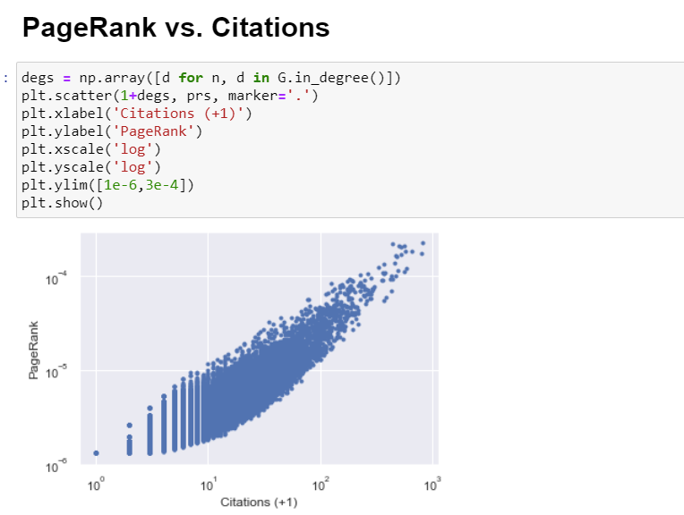
Implementing PageRank
Dataset used: Aminer Citation Network Dataset V1
Implementation is done using Networkx Python package

Slide 21
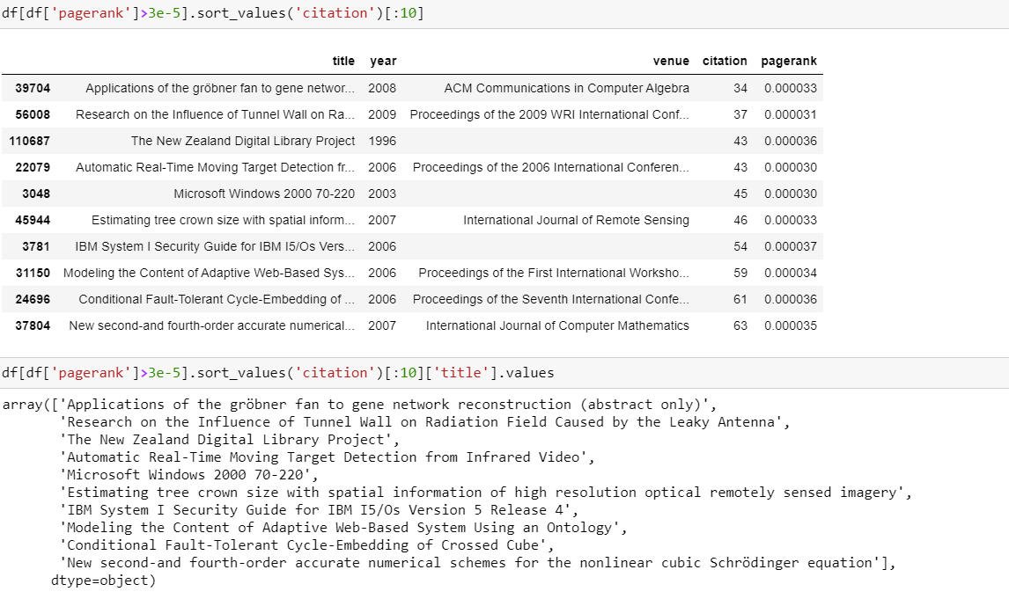
Page Ranking Results
Page Rank results with Correlation Coefficient value 3e-5

Slide 22
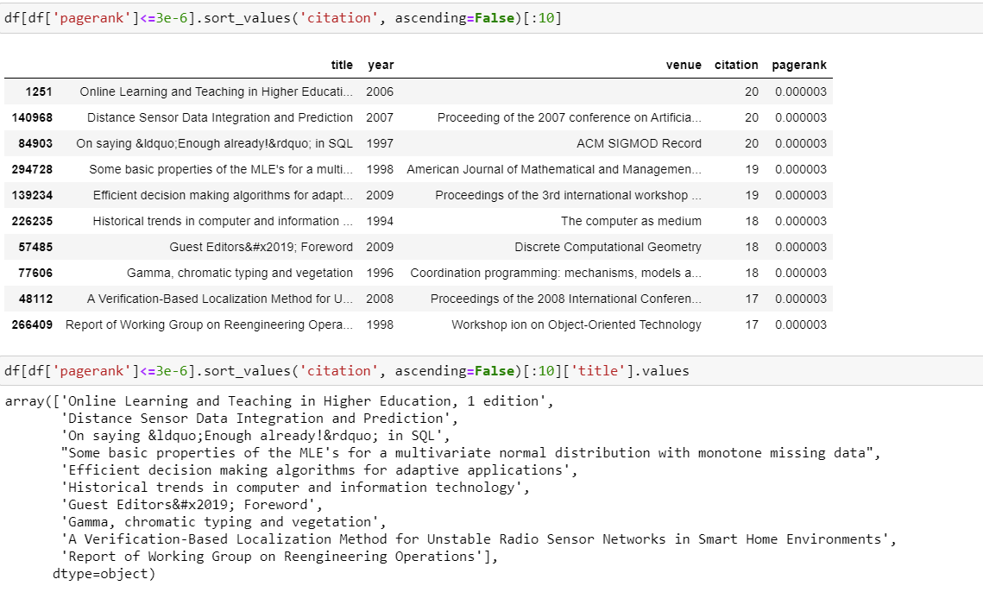
Page Ranking Results
Page Rank results with Correlation Coefficient value 3e-6

Slide 23
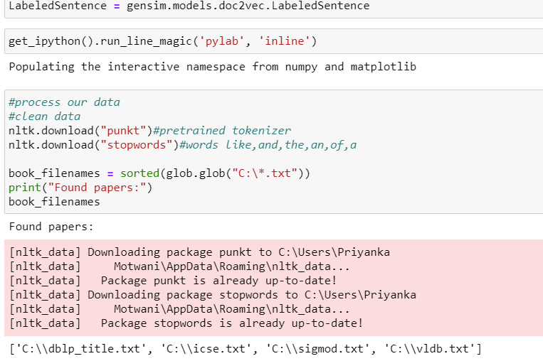
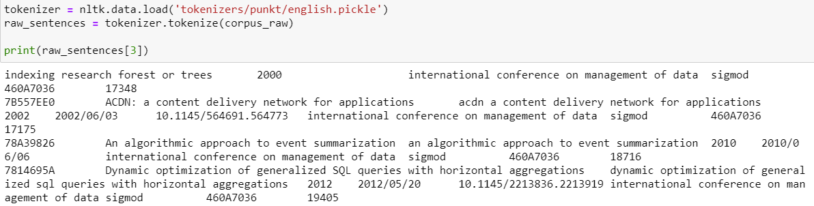
Implementing Doc2vec
Dataset used: ICSE, SIGMOD, VLDB, DBLP_TITLE
Implementation is done using Gensim

Slide 24
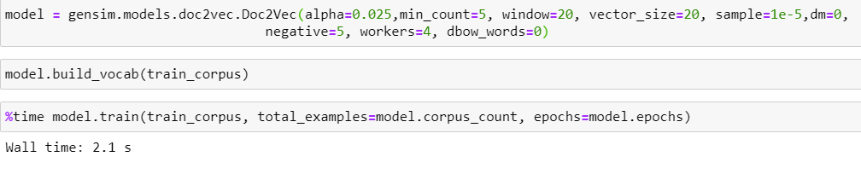
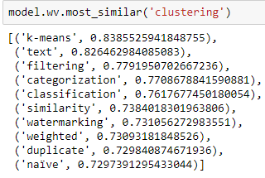
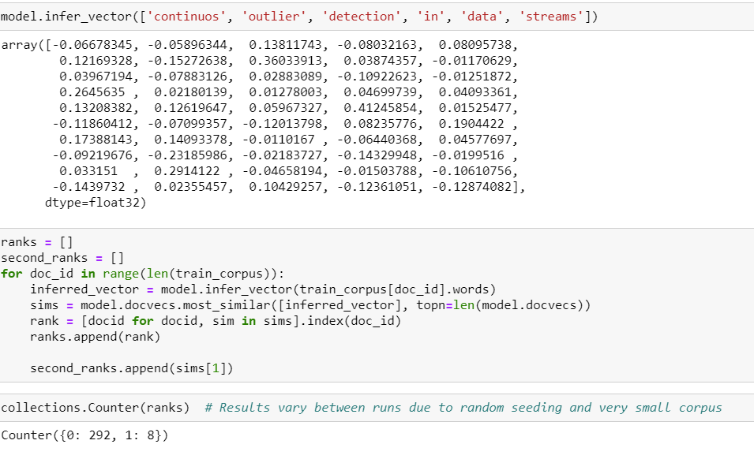
Doc2vec Results
Hyperparameters: alpha=0.025,min_count=5, window=20, vector_size=20, sample=1e-5, dm=0, negative=5, workers=4, dbow_words=0

Slide 25
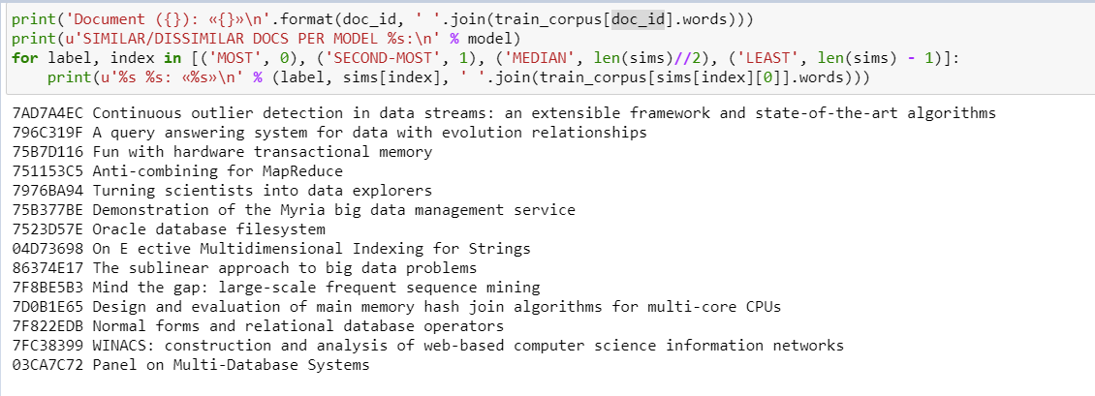
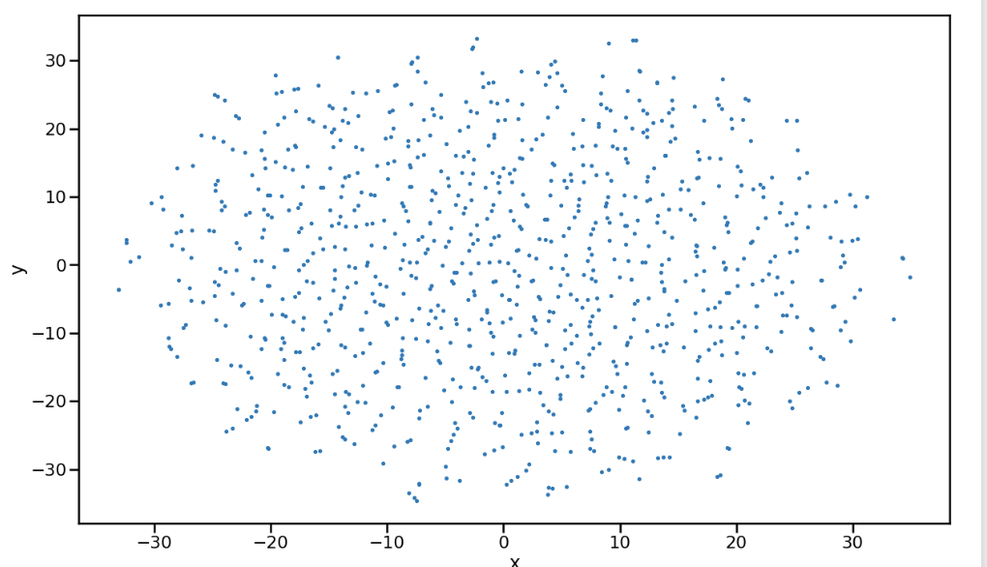
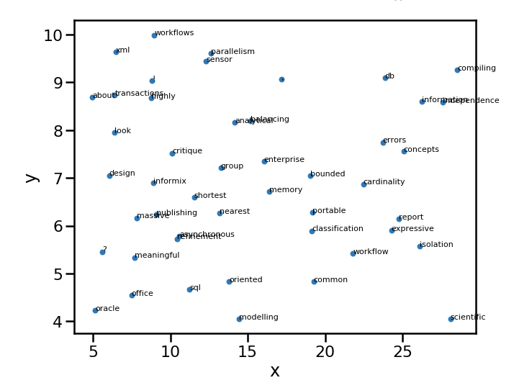
Doc2vec Results
Doc2Vec showing the most similar titles of the documents

Slide 26
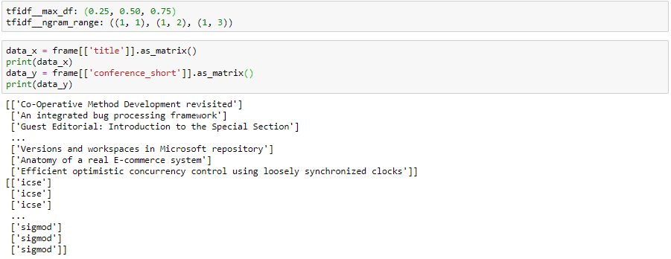
Implementing TF-IDF

Slide 27
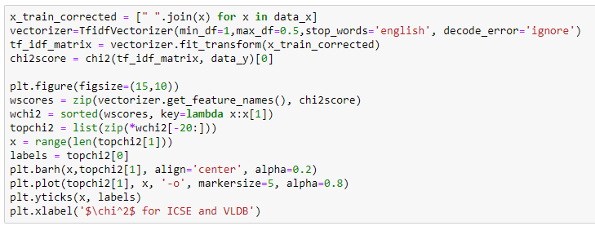
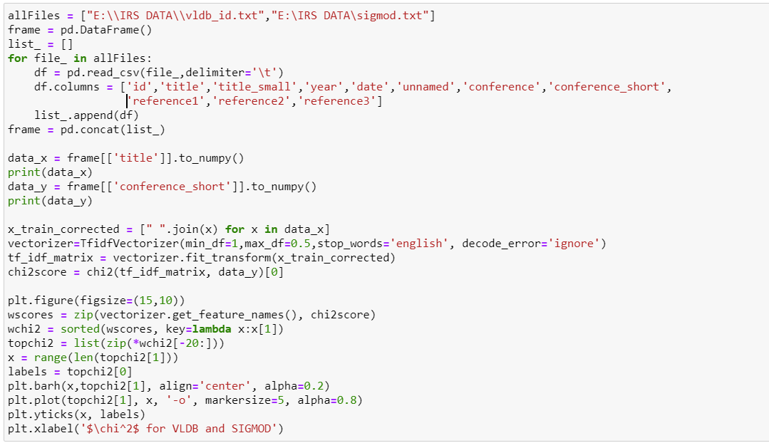
Feature Selection using Chi2
Data Source: ICSE and VLDB
Data Source: Sigmod and VLDB

Slide 28
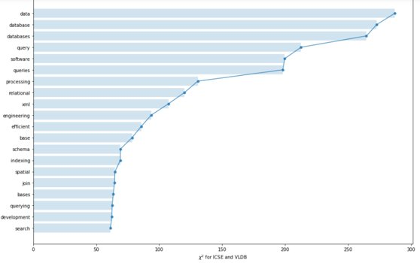
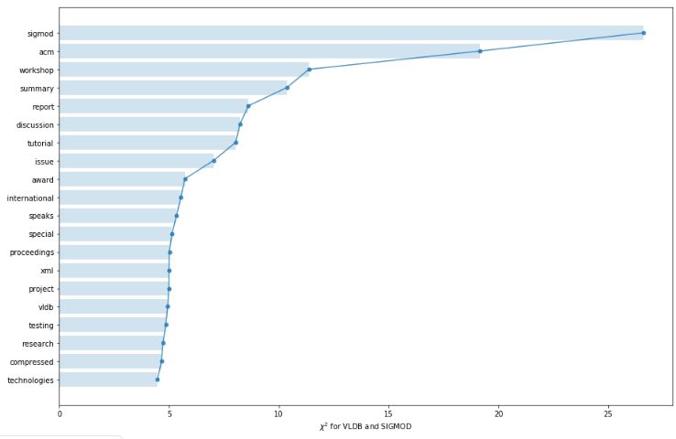
Feature Selection Results
Results for ICSE and VLDB
Results for Sigmod and VLDB

Slide 29
Implementing Classification Algorithms
Data Source: ICSE VLDB SIGMOD
Naïve Bayes
Logistic Regression
Support Vector Machine

Slide 30
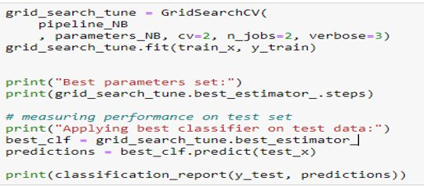
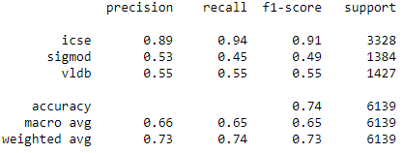
Classification - Naïve Bayes

Slide 31
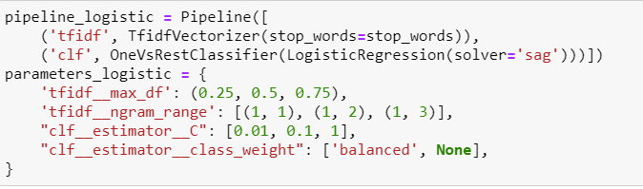
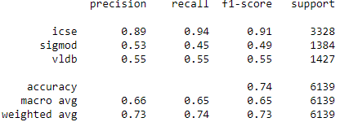
Classification – Logistic Regression

Slide 32
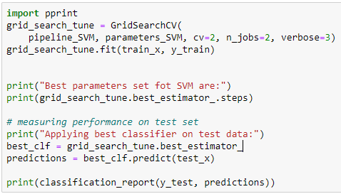
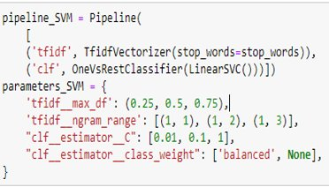
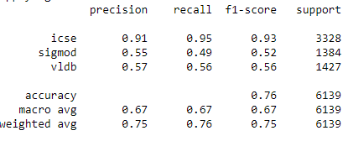
Classification – SVM

Slide 33
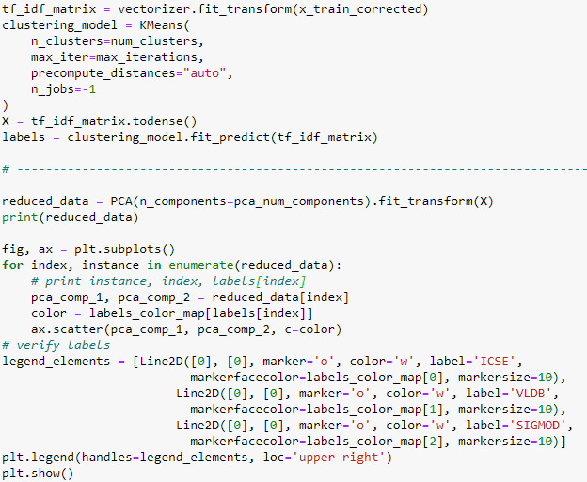
Implementing K-Means Clustering
Kmeans Parameters: num_clusters = 3, num_seeds = 10, max_iterations = 300, pca_num_components = 2
We have used PCA for dimensionality reduction

Slide 34
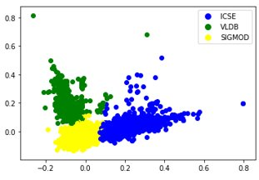
K Means Clustering Results
Dataset used: ICSE, SIGMOD, VLDB
Implementation is done using sklearn library

Slide 35
Conclusion
A Search Engine built for searching of academic conference papers.
Implemented the Search Engine with basic functionalities like Indexing and Searching
Improvements added include the fast searching, query processing
Features added include Highlighting, Spellchecking, Autocomplete.
Additional features include word2vec, doc2vec, Page Ranking, TF-IDF, Feature Selection, Classification and Clustering
Added a basic GUI to the Search Engine to display the results
Further can be expanded to build a proper website and with larger datasets in other domains.

Slide 36
References
http://jlu.myweb.cs.uwindsor.ca/538/
https://introcs.cs.princeton.edu/java/16pagerank/
https://medium.freecodecamp.org/
https://rare-technologies.com
https://medium.com/@zafaralibagh6/a-simple-word2vec-tutorial-61e64e38a6a1
https://cwiki.apache.org/confluence/display/LUCENE/PageRank
https://towardsdatascience.com/feature-selection-techniques-for-classification-and-python-tips-for-their-application-10c0ddd7918b
https://radimrehurek.com/gensim/models/doc2vec.html
https://towardsdatascience.com/5-powerful-scikit-learn-models-e9b12375320d
https://www.aminer.org/citation

Slide 37
Thank You!
Any Questions?

